Slide 1

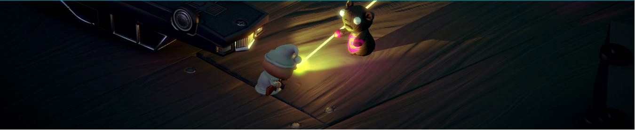
A project work on game development using
OOP (C#)
Supervised BY:
Dr. Md. wahiduzzaman
Associate PROFESSOR
Institute OF Information Technology
Jahangirnagar University
Savar,Dhaka-1342.
submitted BY:
Sifat-E- Jahan
Class Roll: 1936
Khadiza Tul Kubra
Class Roll: 1932
Kowshik Sarker
Class Roll: 2242
Lutfur Rahman Shemanto
Class Roll: 2041

Slide 2
Introduction
Game Designing is a creative medium. There are many game designing tools available for use in schools and at home. It can be used in a number of different ways in our curriculums . Game development is an ideal topic for a joined-up learning approach that is an integral feature of this framework.

Slide 3
ABSTRACTION
Here we can learn how to make a top down isometric survival shooter game with this project. We are going to learn about the editor from putting together scenes implementing animated characters, AI, some of the new UI and a lot of stuffs.

Slide 4
SOFTWARE
1. Unity 5.5 : Unity3D is a powerful cross-platform 3D engine and a user friendly development environment. Unity should interest anybody who wants to easily create 3D games and applications for mobile, desktop, the web, and consoles.
2. Visual Studio : Microsoft Visual Studio is an integrated development environment (IDE) from Microsoft. It is used to develop computer programs for Microsoft Windows, as well as web sites, web apps, web services and mobile apps.

Slide 5
DESCRIPTION
This is a top down isometric survival shooter game.
Here is a boy who is having a dream about all his toys have come to life. He runs around shoot zombie teddies, bears and elephants, scores point and eventually meets his demises. It’s very uplifting game he cannot win he can eventually lose.

Slide 6
We named this game
ZOMNIGHTS

Slide 7
Here are some phases for this game
Environment setup.
Player character.
Camera setup.
Enemy character.
Health HUD.
Player Health.
Harming Enemies.
Scoring Points.
More enemies.
Game over.

Slide 8
Here are some still pictures of our game

Slide 9
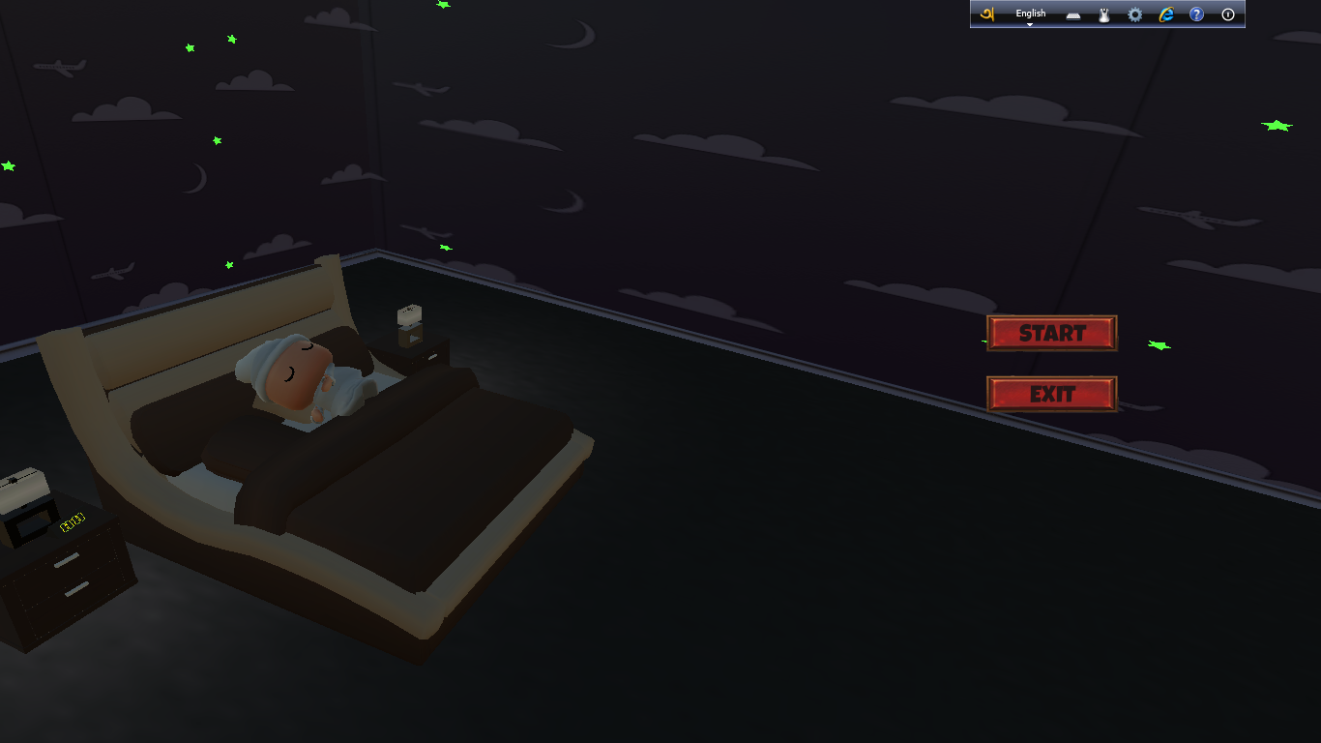

Slide 10
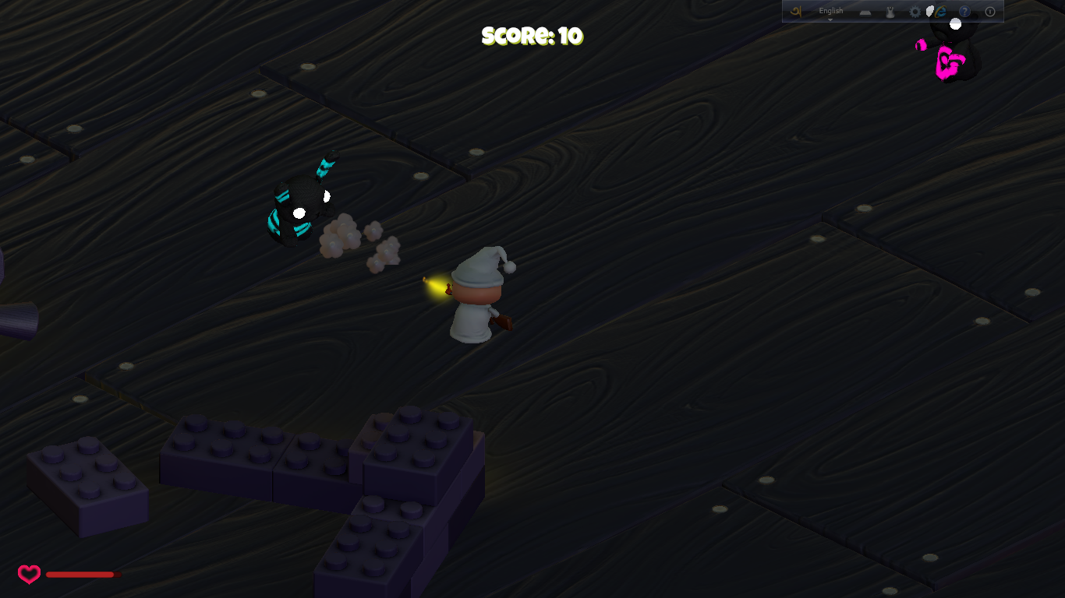

Slide 11
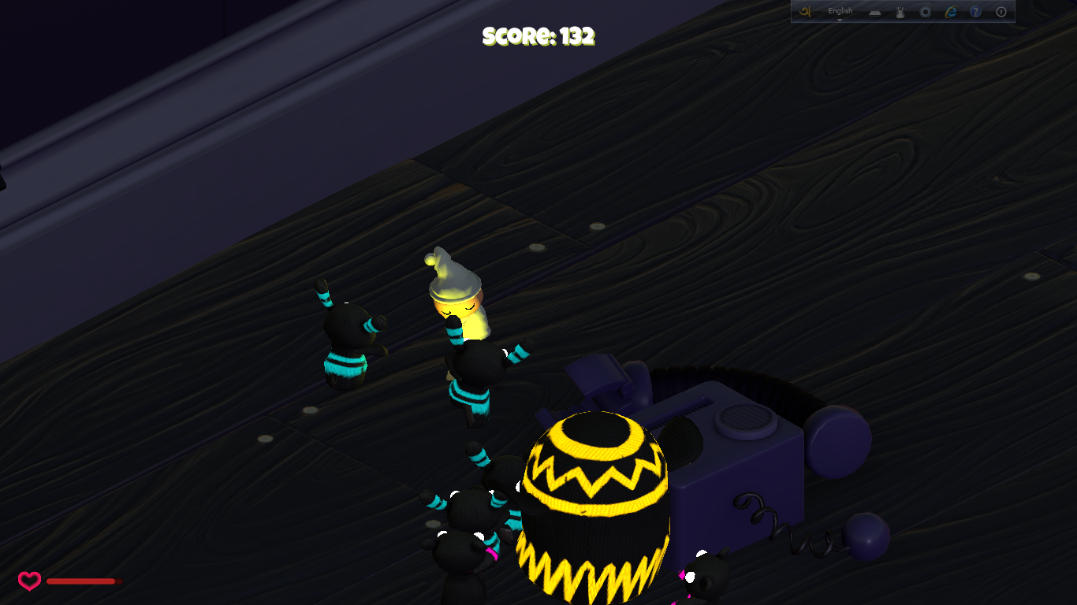

Slide 12
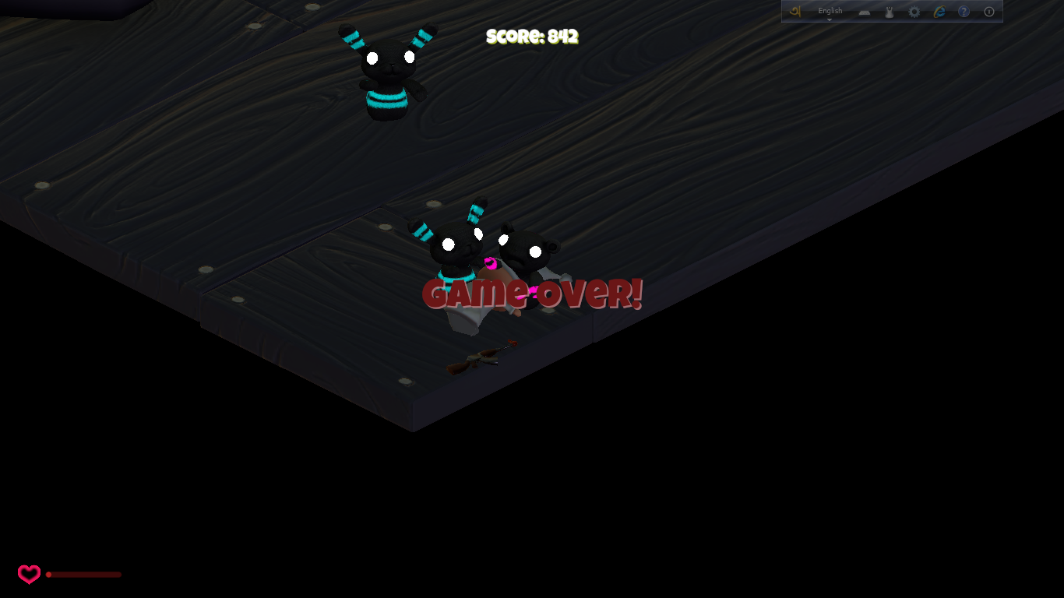

Slide 13
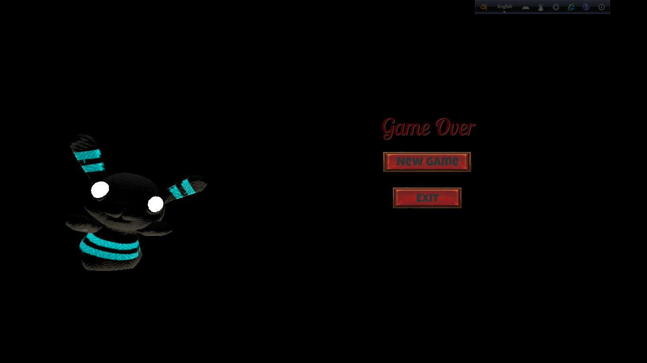

Slide 14
Conclusion
In this project we have considered , Unity platform version 5.5, 3D
Animation, Visual studio, C# language .
It is a isometric top down game where we have used AI and new UI
tools,.
In Future, we will enhance a few several modules so that the kid as
Well as the grown ups can enjoy the game.

Slide 15
THANK YOU

